Slide 1
Park Spending Spending Analysis for Indiana
Gabriel Toscano Analyst September, 2024

Slide 2
Agenda
National Trends in Park Spending
Changes in Spending From 2012
Cities with the Most and Least Park Spending
Comparing Spending to Coverage
Q&A and Contact Information

Slide 3
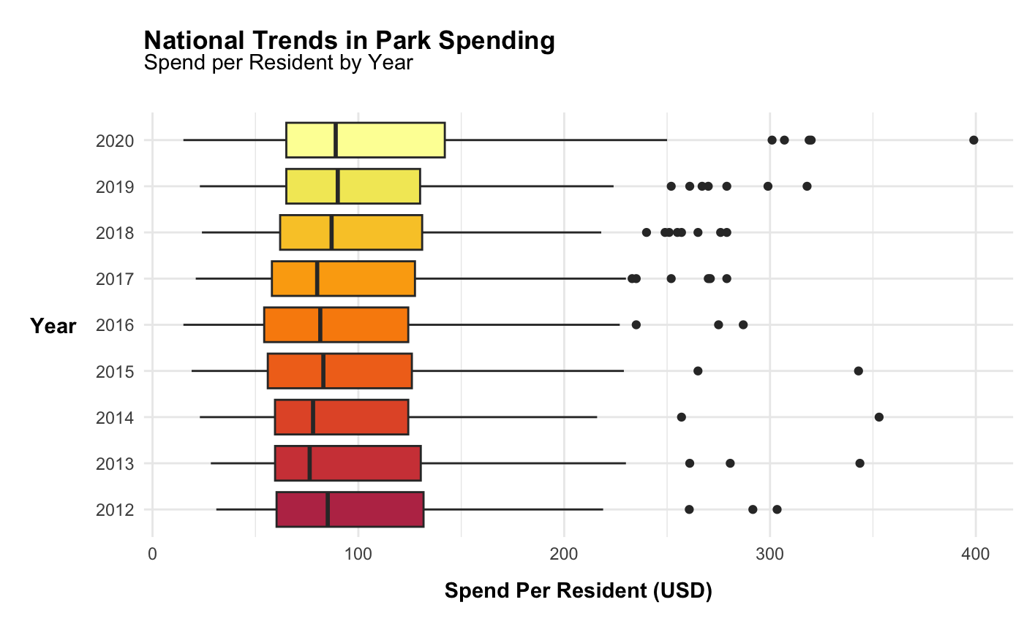
The national average for park spending gradually increased from 2017 onwards
The outlier cities spent more than ever in 2020
1

Slide 4
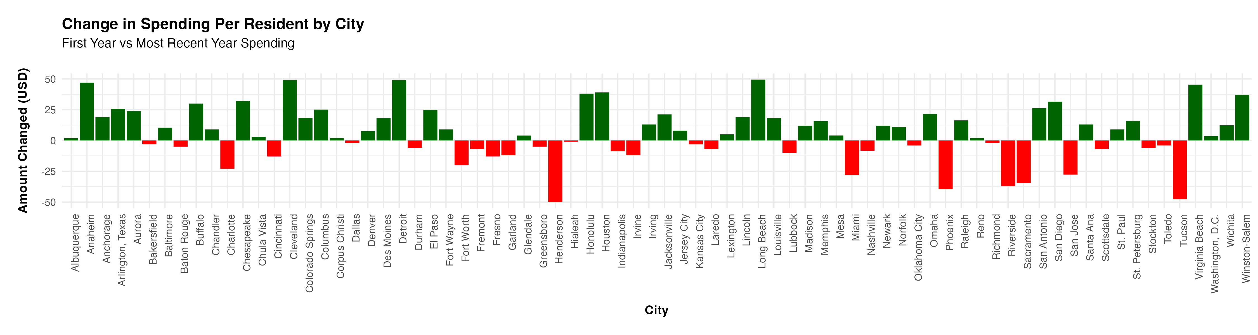
Large swings in spending per resident between 2012 and the most recent year
Largest increases in
Long Beach
Cleveland
Detroit
Anaheim
Houston
Largest decreases in
Henderson
Tucson
Phoenix
Riverside
Sacramento
2

Slide 5
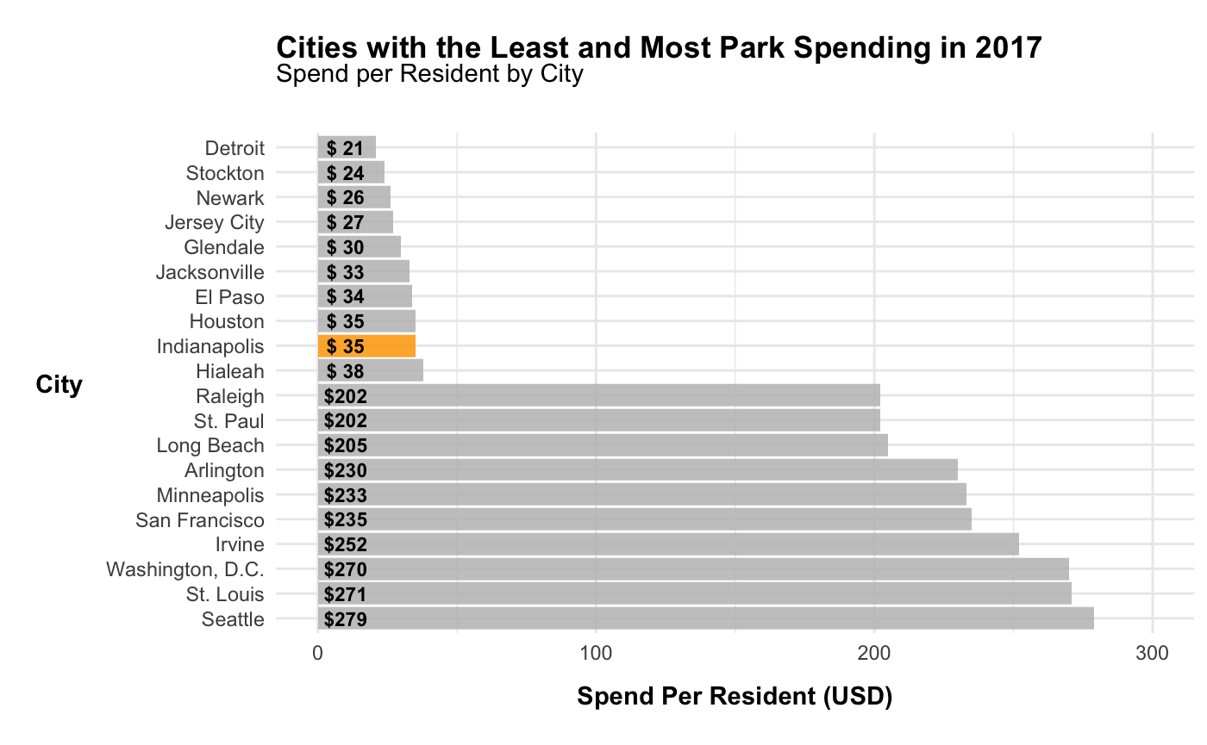
Indianapolis is among the lowest spenders per resident in the country
The gap between the bottom 10 spenders and the top 10 spenders is over $100 per resident
3

Slide 6
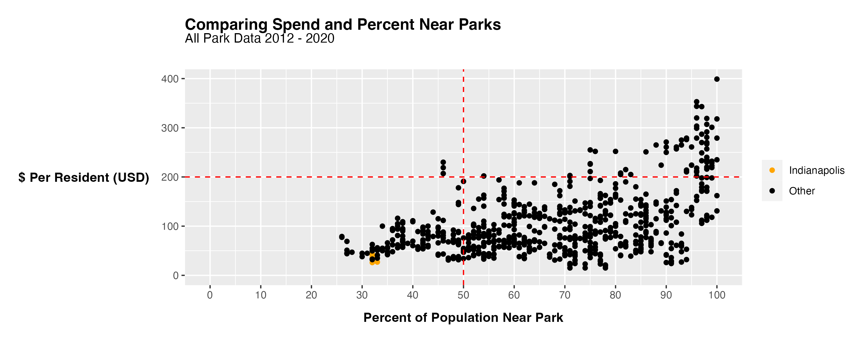
Indianapolis is a among the lowest spenders and has some of the lowest coverage in terms of percent of population near a park
4

Slide 7
High spend
Low Coverage
High spend
High coverage
Low spend
Low coverage
Low spend
High coverage
Many cities in the low spend, high coverage quadrant provide 50% or more coverage at the same level of spending per resident as Indianapolis
5

Slide 8

Q&A
Gabriel Toscano
gabriel.toscano@duke.edu
linkedin.com/gabriel-toscano/

